Slide 1
Chapter 6:
Logical database design and the relational model

Slide 2
Objectives of logical design...
Translate the conceptual design into a logical database design that can be implemented on a chosen DBMS
  Input: conceptual model (ERD)
  Output: relational schema, normalized relations
Resulting database must meet user needs for:
  Data sharing
  Ease of access
  Flexibility

Slide 3
Relational database components
Data structure
  Data organized into tables
Data manipulation
  Add, delete, modify, and retrieve using SQL
Data integrity
  Maintained using business rules

Slide 4
Why do I need to know this?
Mapping conceptual models to relational schema is straight-forward
CASE tools can perform many of the steps, but..
  Often CASE cannot model complexity of data and relationship (e.g., Ternary relationships, supertype/subtypes)
  There are times when legitimate alternates must be evaluated
  You must be able to perform a quality check on CASE tool results

Slide 5
Some rules...
Every table has a unique name.
Attributes in tables have unique names.
Every attribute value is atomic.
  Multi-valued and composite attributes?
Every row is unique.
The order of the columns is irrelevant.
The order of the rows is irrelevant.

Slide 6
The key...
Relational modeling uses primary keys and foreign keys to maintain relationships
Primary keys are typically the unique identifier noted on the conceptual model
Foreign keys are the primary key of another entity to which an entity has a relationship
Composite keys are primary keys that are made of more than one attribute
  Weak entities
  Associative entities

Slide 7
Implementing it
Attribute
Instance
Field
Entity

Slide 8
What about relationships?

Slide 9
Constraints
Domain constraints
  Allowable values for an attribute as defined in the domain
Entity integrity constraints
  No primary key attribute may be null
Operational constraints
  Business rules
Referential integrity constraints

Slide 10
Referential integrity constraint
Maintains consistency among rows of two entities
  matching of primary and foreign keys
Enforcement options for deleting instances
  Restrict
  Cascade
  Set-to-Null

Slide 11
Transforming the EER diagram into relations
The steps:
Map regular entities
Map weak entities
Map binary relationships
Map associative entities
Map unary relationships
Map ternary relationships
Map supertype/subtype relationships

Slide 12
Transforming E-R diagrams into relations
Mapping regular entities to relations
  Composite attributes: use only their simple, component attributes
  Multi-valued attributes: become a separate relation with a foreign key taken from the superior entity

Slide 13

Mapping a composite attribute

Slide 14
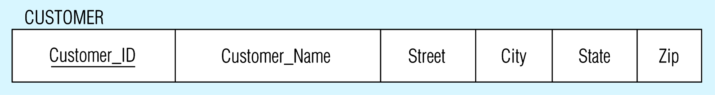
Looks like this using relational schema notation

Slide 15
Transforming E-R diagrams into relations
Mapping weak entities
  Becomes a separate relation with a foreign key taken from the superior entity

Slide 16
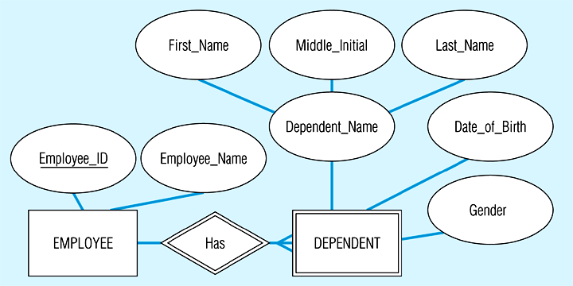
Example of mapping a weak entity

Slide 17
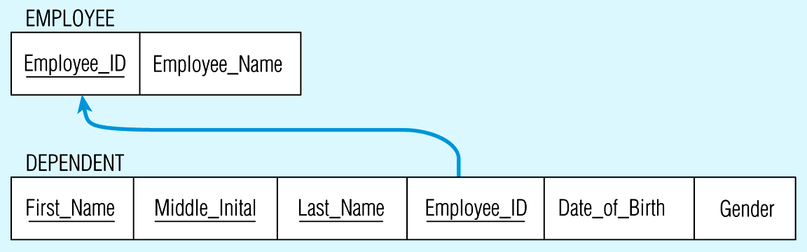
Looks like this using relational schema notation

Slide 18
Transforming E-R diagrams into relations
Mapping binary relationships
  One-to-many - primary key on the one side becomes a foreign key on the many side
  Many-to-many - create a new relation (associative entity) with the primary keys of the two entities as its primary key
    I like to call these intersection entities to distinguish them from associative entities created at the conceptual level
  One-to-one - primary key on the mandatory side becomes a foreign key on the optional side

Slide 19
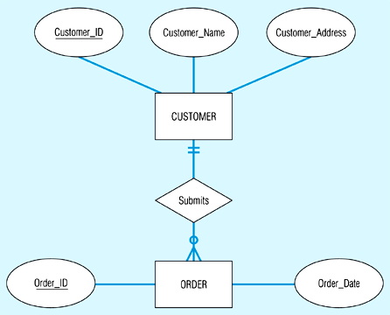
Example of mapping a 1:M relationship

Slide 20
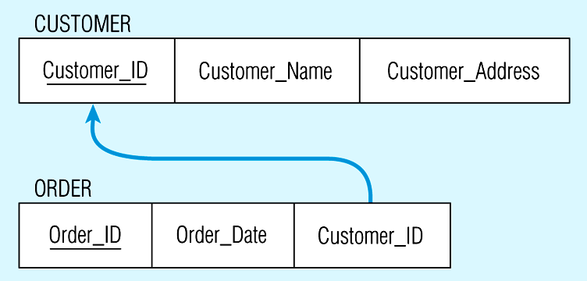
Looks like this using relational schema notation

Slide 21
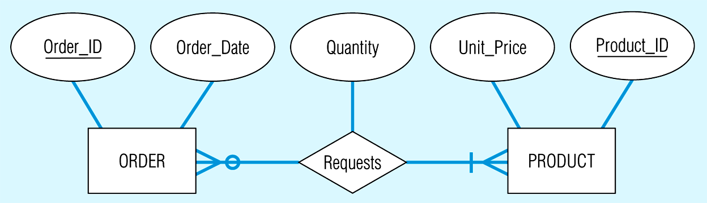
Example of mapping an M:M relationship

Slide 22
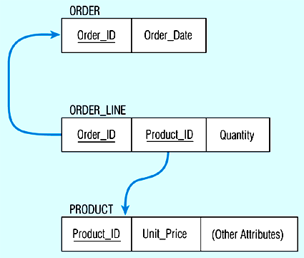
Looks like this using relational schema notation

Slide 23
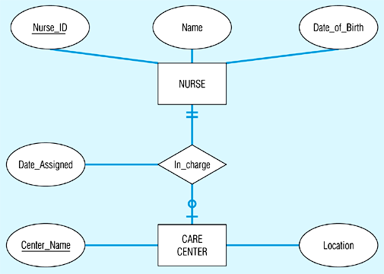
Mapping a binary 1:1 relationship

Slide 24
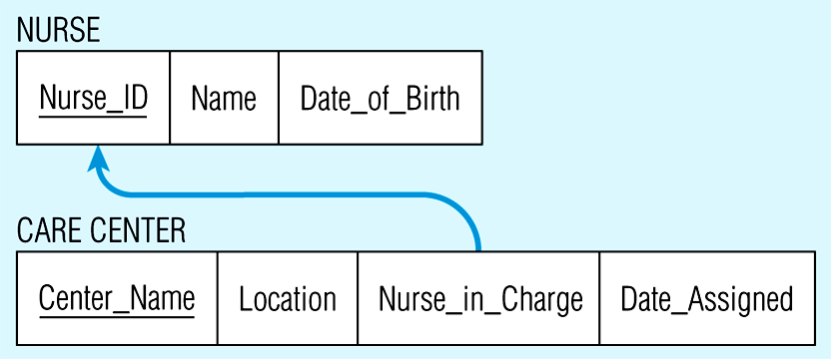
Looks like this using relational schema notation

Slide 25
Transforming E-R diagrams into relations
Mapping associative entities
  Identifier not assigned
    Default primary key for the association relation is the primary keys of the two entities
  Identifier assigned
    It is natural and familiar to end-users
    Default identifier may not be unique

Slide 26
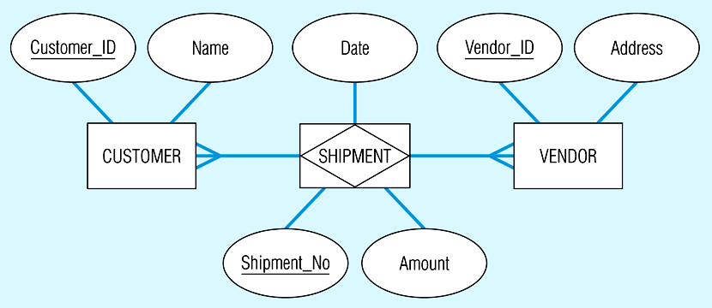
Mapping an associative entity with an identifier

Slide 27
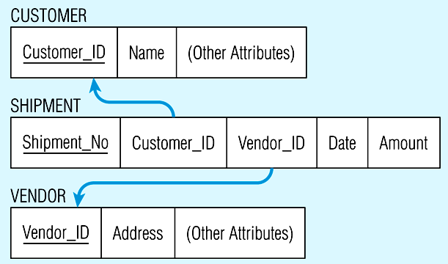
Looks like this using relational schema notation

Slide 28
Transforming E-R diagrams into relations
Mapping unary relationships
  One-to-many - recursive foreign key in the same relation
  Many-to-many - two relations:
    One for the entity type
    One for an associative relation in which the primary key has two attributes, both taken from the primary key of the entity

Slide 29
For example...
Emp_Num
Supervises
EMPLOYEE
Emp-Name
Emp_Address

Slide 30
Would look like...
references
Emp_Num Emp_Name Emp_Address Boss_Num

Slide 31
And..
Num_Units
Comp_Num
BOM
COMPONENT
Description
Unit_of-Measure

Slide 32
Would look like...
COMPONENT
Comp_Num Desc Unit_of_Measure
BOM
Num-of_Units Comp_Num Subassembly_Num

Slide 33
Transforming E-R diagrams into relations
Mapping ternary (and n-ary) relationships
  One relation for each entity and one for the associative entity

Slide 34
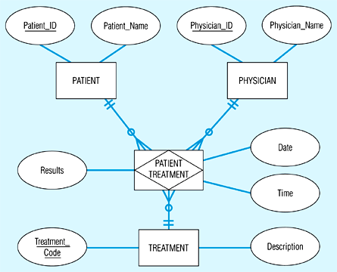
Mapping a ternary relationship

Slide 35
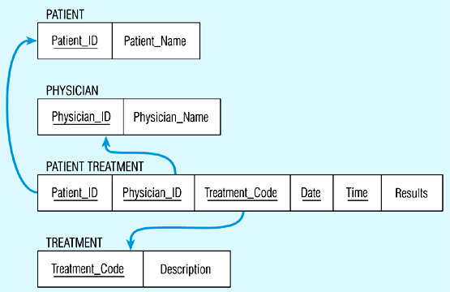
Looks like this using relational schema notation

Slide 36
Transforming E-R diagrams into relations
Mapping Supertype/subtype relationships
  Create a separate relation for the supertype and each of the subtypes
  Assign common attributes to supertype
  Assign primary key and unique attributes to each subtype
  Assign an attribute of the supertype to act as subtype discriminator

Slide 37
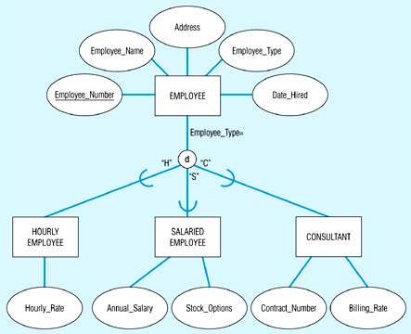
Mapping Supertype/subtype relationships

Slide 38
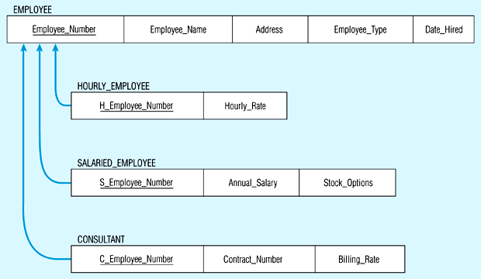
Would look like this...

Slide 39
Let’s try a couple….

Slide 40
Well-structured relations
Well-structured relations contain minimal redundancy and allow insertion, modification, and deletion without errors or inconsistencies
Anomalies are errors or inconsistencies resulting from redundancy
  Insertion anomaly
  Deletion anomaly
  Modification anomaly

Slide 41
Data normalization
Normalization is a formal process for deciding which attributes should be grouped together in a relation
  Objective: to validate and improve a logical design so that it satisfies certain constraints that avoid unnecessary duplication of data
  Definition: the process of decomposing relations with anomalies to produce smaller, well-structured relations

Slide 42
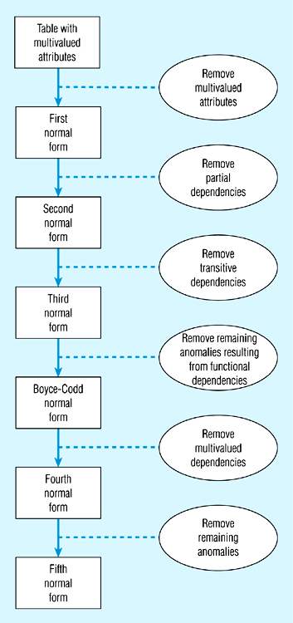
Steps in normalization

Slide 43
Functional dependencies and keys
Functional dependency: the value of one attribute (the determinant) determines the value of another attribute
  A -> B, for every valid instance of A, that value of A uniquely determines the value of B
Candidate key: an attribute or combination of attributes that uniquely identifies an instance
  Uniqueness: each non-key field is functionally dependent on every candidate key
  Non-redundancy

Slide 44
First normal form
No multi-valued attributes.
Every attribute value is atomic.

Slide 45
Second normal form
1NF and every non-key attribute is fully functionally dependent on the primary key.
Every non-key attribute must be defined by the entire key, not by only part of the key.
No partial functional dependencies.

Slide 46
Third normal form
2NF and no transitive dependencies (functional dependency between non-key attributes.)

Slide 47
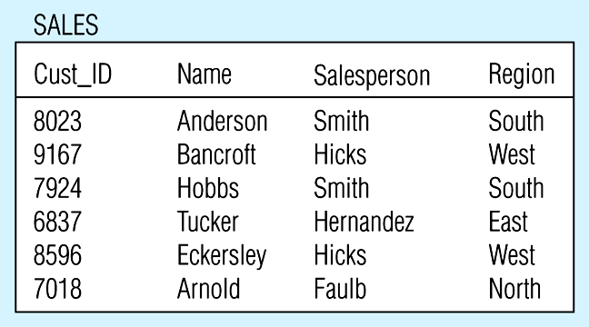
Relation with transitive dependency

Slide 48
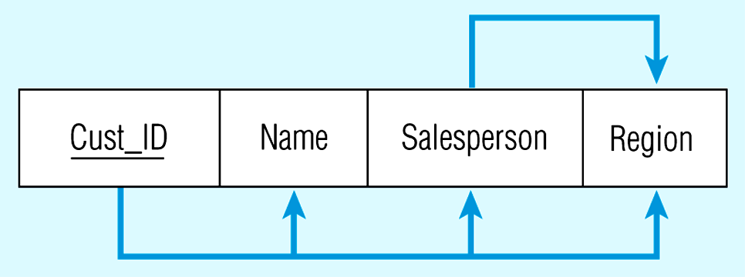
Transitive dependency in SALES relation

Slide 49
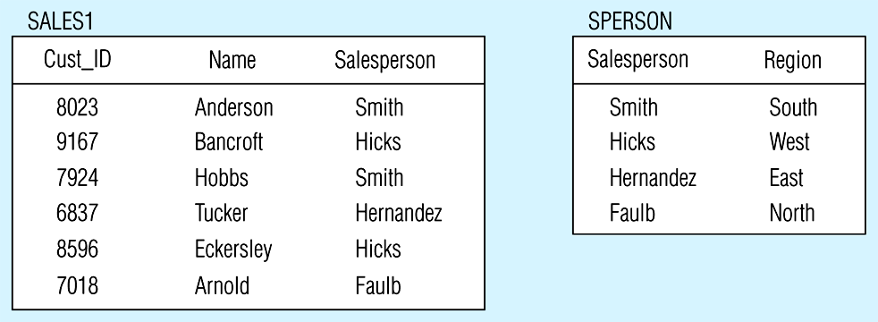
Removing a transitive dependency

Slide 50
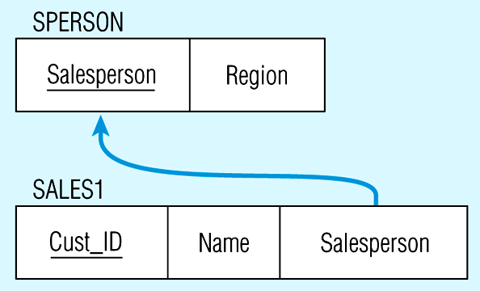
Relations in 3NF

Slide 51
Let’s practice...

Slide 52
Other considerations...
Synonyms: different names, same meaning.
Homonyms: same name, different meanings.

